Slide 1
Operation Analytics and Investigating Metric Spike
Operational Analytics helps analyze a company's operations to find areas for improvement.
Investigating metric spikes focuses on understanding sudden changes in key metrics (e.g., drop in user engagement or sales).

Slide 2
Approach
Understand the Data:
Looked at the data provided (e.g., users, events, email events) to understand what information is available.
Identified the important metrics (like user engagement and sales).
Define the Problem:
Focused on identifying sudden changes in key metrics (like spikes or drops).
Decided which metrics to track closely (e.g., number of logins, sales, email opens).
SQL Analysis:
Wrote SQL queries to analyze data over time (like weekly or monthly trends).
Used SQL techniques to group, filter, and calculate important data points.
Investigate Spikes:
Looked for unusual spikes or drops in metrics (e.g., more users logging in one day).
Explored possible reasons for these changes, like marketing campaigns or product updates.
Insights and Action:
Interpreted the data and shared what could be causing the changes.
Suggested steps to improve business operations based on the findings.

Slide 3
Tech-Stack Used
MySQL Workbench (Version 8.0)
Purpose: Used for writing and executing SQL queries to analyze the data.
Provides a user-friendly interface for managing databases and visualizing data.
SQL (Structured Query Language)
Purpose: The main tool used for querying the data, filtering information, and performing calculations to identify trends, spikes, and anomalies.
Excel (Optional, for analysis and reporting)
Purpose: Sometimes used for further analysis or to present results in a more visual format (e.g., charts and tables).

Slide 4
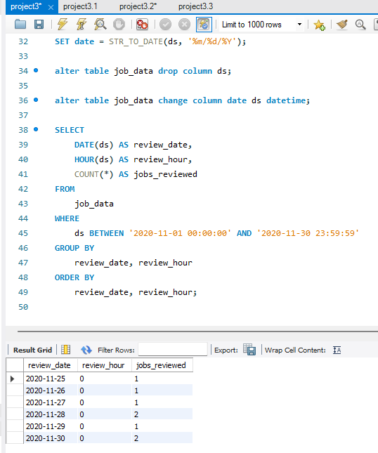
Jobs Reviewed Over Time:
By calculating the number of jobs reviewed
per hour for each day, I observed patterns in job review activity,
such as peak review hours and potentially slow review periods.
The data helped identify if certain times
of the day were more productive, which can inform
workflow improvements and staffing decisions.

Slide 5
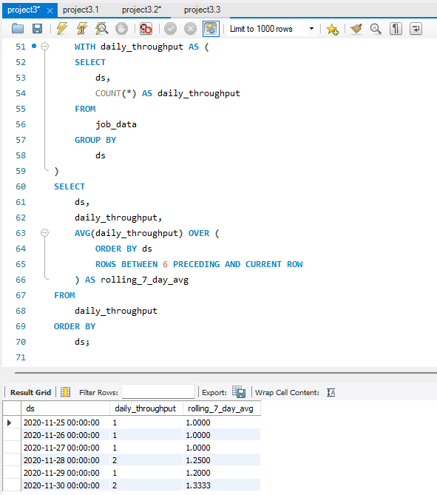
Throughput Analysis:
This metric helped in The 7-day rolling average provided a clearer view of throughput over time, smoothing out daily fluctuations.
identify trends, such as periods of high or low activity, that could correspond with operational changes or external factors.

Slide 6
Daily Metric vs 7-Day Rolling Average
Daily Metric:
Pros:
Provides an accurate snapshot of throughput on a specific day.
Good for real-time monitoring or detecting daily spikes/drops.
Cons:
Can be highly volatile due to daily fluctuations or outliers.
It might be misleading if there are anomalies on specific days (e.g., weekends, holidays).
7-Day Rolling Average:
Pros:
Smoothens out short-term fluctuations, giving a more stable and reliable trend over time.
Reduces the impact of one-off events or anomalies on a single day.
Useful for identifying long-term trends and making strategic decisions.
Cons:
Less reactive to sudden changes in throughput because it averages data over a week.
May not highlight immediate issues that need daily monitoring.
Preference:
I prefer using the 7-day rolling average for throughput, especially when analyzing long-term trends. It smoothens out the short-term variability and provides a clearer picture of overall performance trends. This is particularly useful when dealing with datasets that have a lot of noise or variability on a day-to-day basis. However, for real-time operational monitoring or detecting anomalies quickly, the daily metric is more suitable. The choice ultimately depends on the context of analysis (trend tracking vs. real-time monitoring).

Slide 7
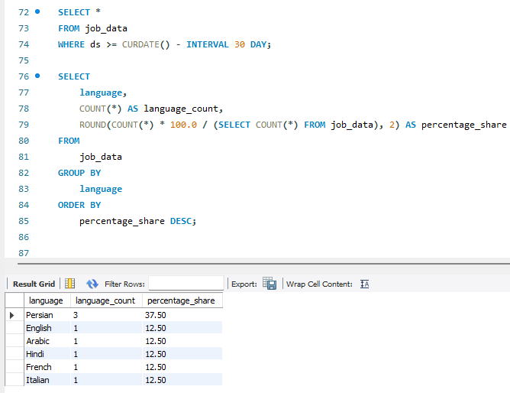
Language Share Analysis:
By calculating the percentage share of each language over the last 30 days, I discovered which languages were most frequently reviewed.
This insight could be valuable for resource allocation, such as ensuring language-specific content reviewers are available during peak periods.

Slide 8
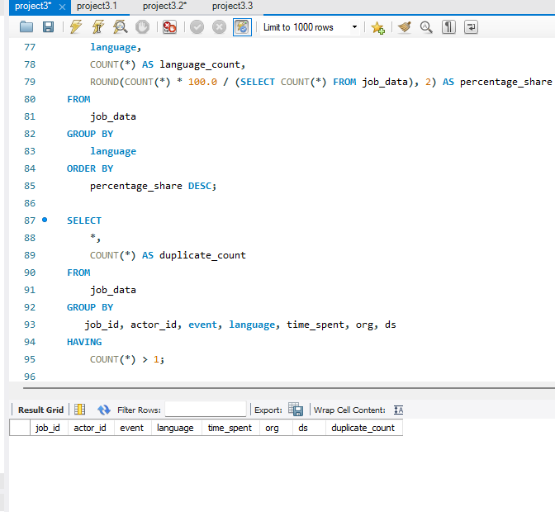
Duplicate Rows Detection:
Identifying and removing duplicate rows ensured data integrity and accuracy.
This process helped maintain the quality of analysis, ensuring that repeated records did not skew metrics like time spent or event counts.

Slide 9
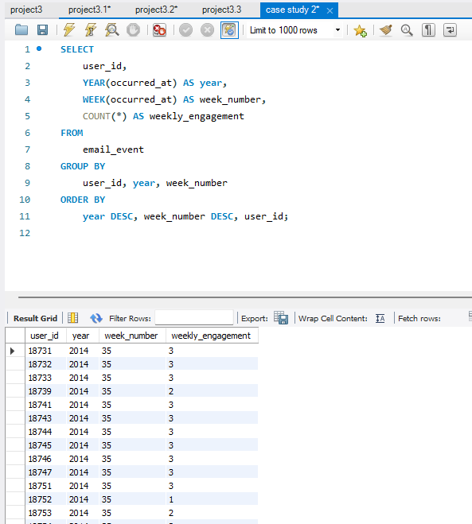
Weekly User Engagement:
By calculating weekly user engagement, I observed trends in how frequently users interacted with the platform.
This analysis highlighted peak activity periods and low-engagement weeks, which could be useful for scheduling promotions or content updates. Identifying weekly patterns helps to tailor marketing or operational strategies for maximum user engagement.

Slide 10
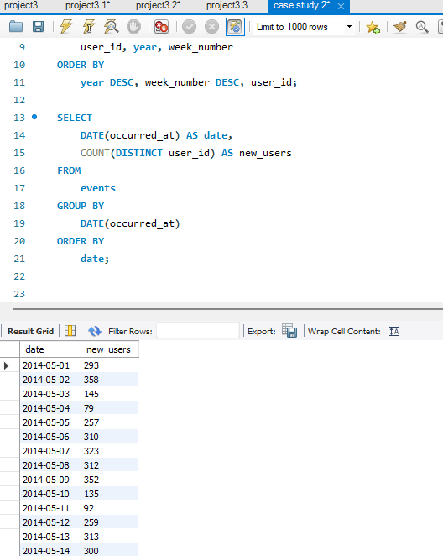
User Growth Analysis:
The user growth analysis revealed how the user base expanded over time. By analyzing this data, I was able to pinpoint periods of rapid growth or stagnation.
These insights are valuable for understanding the effectiveness of marketing campaigns or product updates in attracting new users.

Slide 11
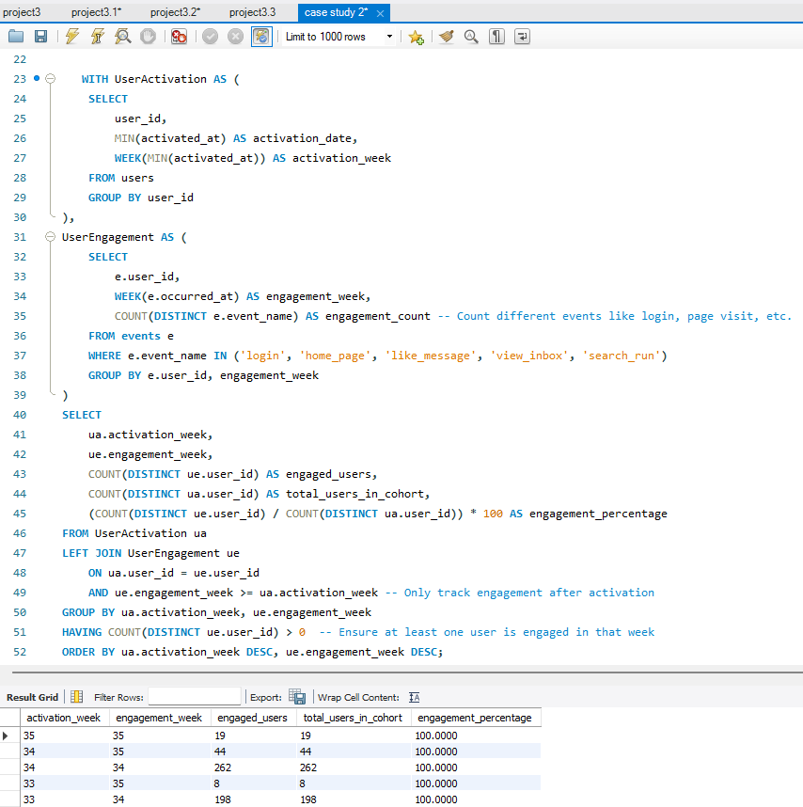
Weekly Retention Analysis:
Retention analysis helped to measure how many users continued to engage with the product week after week.
Insights from this data indicate whether new user experiences are contributing to long-term engagement or if retention strategies need improvement. It also helped to identify user cohorts that might need further attention.

Slide 12
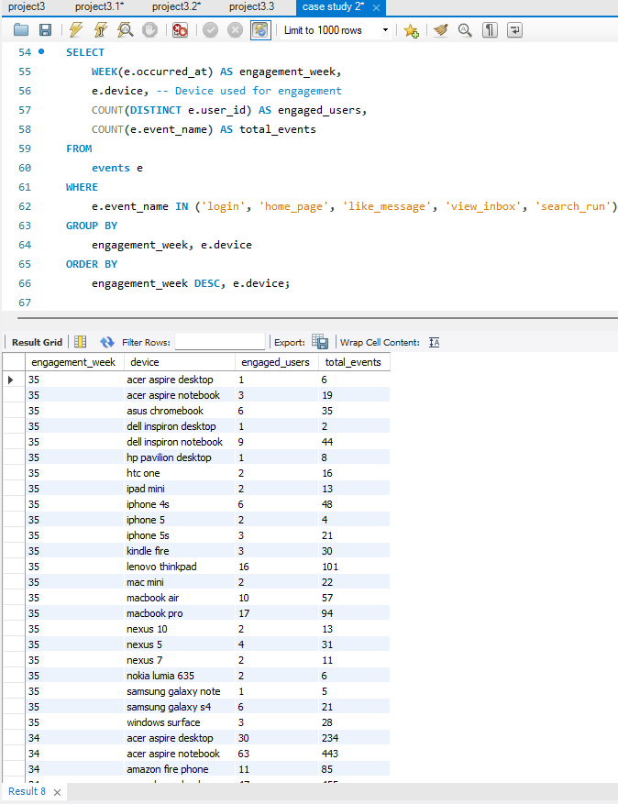
Weekly Engagement Per Device:
By measuring weekly engagement per device, I was able to analyze which devices were most commonly used by active users.
This information helps in optimizing the platform for popular devices and can guide future product decisions, ensuring the platform is optimized for user preferences.

Slide 13
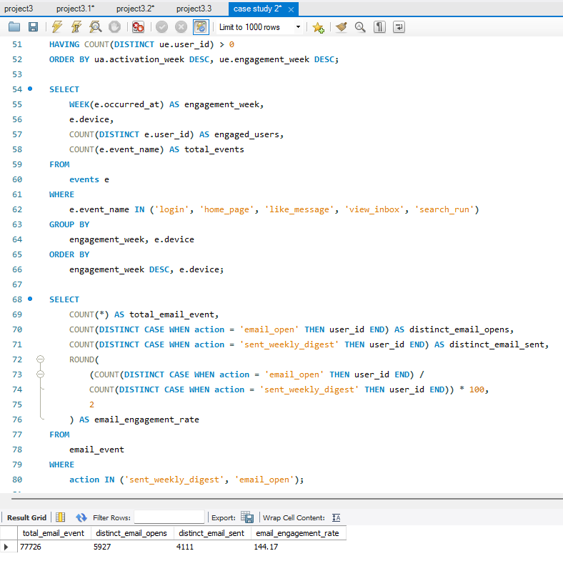
Email Engagement Analysis:
The email engagement analysis provided insight into how users were interacting with email communications (e.g., email opens and click-throughs).
Understanding email engagement metrics helps optimize email campaigns for better outreach, tailoring messages based on user behavior and maximizing the effectiveness of communication.

Slide 14
Key Achievements:
Through this project, I successfully analyzed various aspects of user engagement, growth, retention, and email interaction. By calculating weekly user engagement, I identified trends that allowed for targeted efforts to boost interaction. The user growth analysis revealed acquisition trends over time, helping to optimize marketing strategies. Tracking weekly retention provided valuable insights into churn patterns, guiding improvements in retention tactics. The device-specific engagement analysis offered insights into user preferences, enabling more informed product development decisions. Lastly, the email engagement analysis evaluated the effectiveness of email campaigns, allowing for more tailored and impactful marketing strategies. Overall, this project helped to drive data-informed decision-making that optimized user experience, marketing strategies, and product development efforts.

